Slide 1
Seminar
on
“Virtual Reality”
Presented by
Pranay Vijay Shahare
M.Sc.(CS) Sem-1
Guided By
Dr. J. K. Keche
Assistant Professor
DEPARTMENT OF COMPUTER SCIENCE
Shri Shivaji Science Education Society Amaravati’s
SCIENCE COLLEGE
CONGRESS NAGAR, NAGPUR – 440012
2020-2021

Slide 2
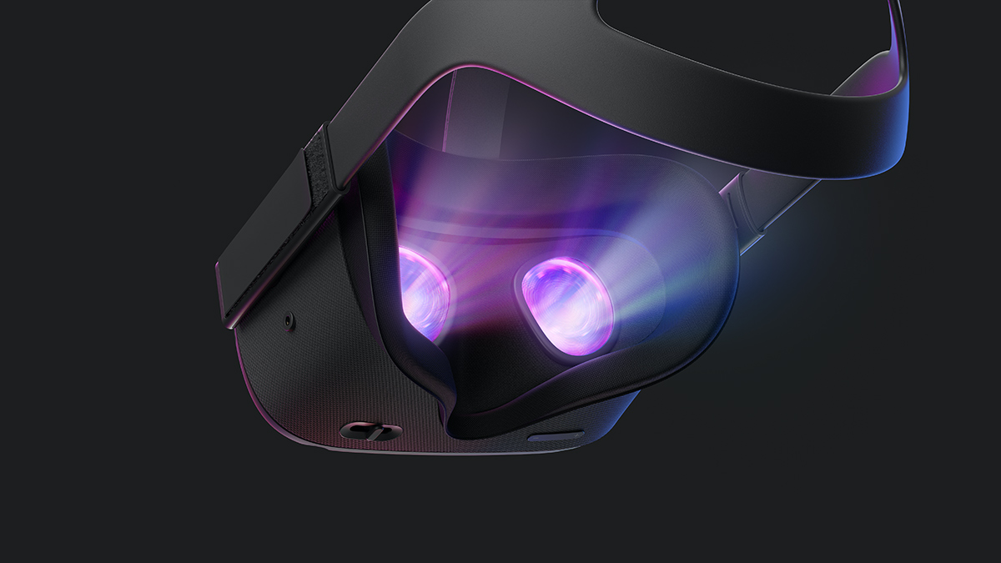
Contents
INTRODUCTION
OBJECTIVE
FEATUERS
WORKING
ADVANTAGES
DISADVANTAGE
CONCLUSION
FUTURE SCOPE
REFERENCES

Slide 3
Introduction
What is Virtual Reality (VR) ?
Virtual Reality is a form of technology which creates computer generated worlds or immersive environment which people can explore and in many cases, interact with.
Why Virtual Reality (VR) ?
VR is able to immerse you in a computer-generated world of your own making a room, a city, the interior of human body. With VR you can explore any uncharted territory of the human imagination.

Slide 4
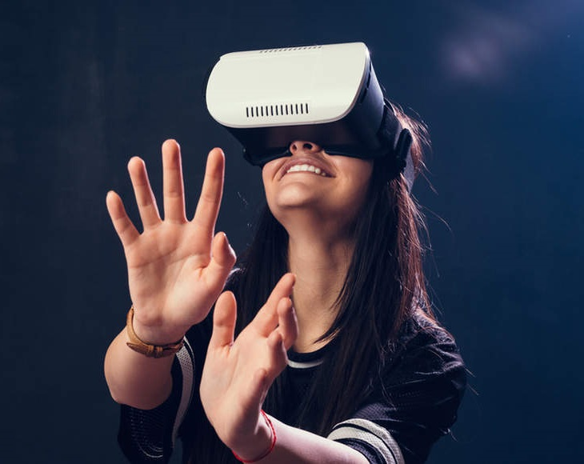
objective
The goal of VR is to provide human beings a virtual environment where we can interact with a computer just as we do in the real world, that is, by talking with a virtual human in a spoken language by writing a letter or by drawing a picture.
Ideally, user is presented with a make believe world created by the system.

Slide 5
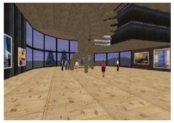
features
A medium of communication.
Requires physical immersion.
Provides synthetic sensory simulation.
Interactive gaming like experience to user to view the whole project.
Based on current VR system, it can be concluded that three major senses are tackled by most VR system are :
» Vision » Hearing » Touch

Slide 6
working
Processing of virtual reality is a combination of both hardware and software. The hardware part is used for viewing purposes, while the software can help create the environment.
Virtual reality is the presentation of a user interface in 3D. While monitors and TV screens only allow a limited 3D experiences, virtual reality can be a 360-degree immersive experience, where computer-generated graphics create things as close to reality as possible.

Slide 7
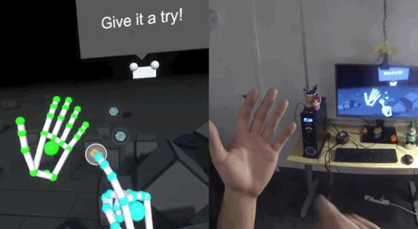
Virtual Reality View clip

Slide 8
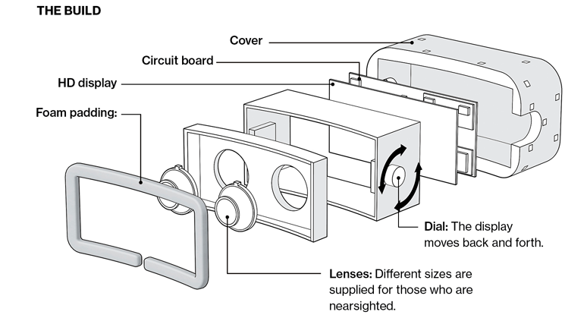
Inside view of VR box
VR BOX

Slide 9
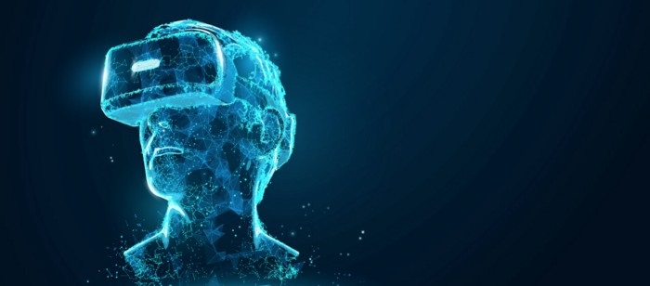
advantages
Virtual Reality create a realistic world.
It enable user to explore places.
Through Virtual Reality user can experiment with an artificial environment.
Virtual Reality make the education more easy and comfortable.

Slide 10

disadvantages
The equipments used in Virtual Reality are very expensive.
It consists of complex technology.
In Virtual Reality environment we can’t move by our own like in the real world.

Slide 11
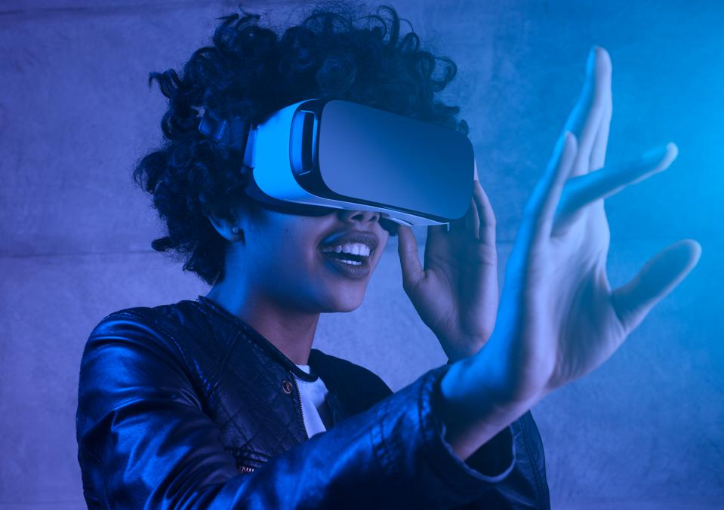
conclusion
In every generation, there is a technology that defines them.
Virtual Reality is proving to be a positive impact on healthcare.
The concept of Virtual Reality provides an innovative mix of entertainment, education and State-of-art.

Slide 12
Future scope
Virtual Reality is a growing industry.
Visualization of complicated, large data is helpful for understanding and analysis.
PC and specialized hardware are getting better and faster because of development in VR.
VR enables us to experience the virtual world that is impossible in real world.
Revolution in gaming industries.

Slide 13
references
3D Animation UK Studios creating Virtual Reality Pictures UK 3D Animation company has a Computer Graphics portfolio that includes UK Architectural Rendering, UK Product Visualisation, 3D Virtual Tours.
J. Balaguer, E. Gobetts, Leaving Flatland, From the Desktop Metaphor to Virtual Reality, EUROGRAPHICS 95 Tutorial, No. 5 (1995)
P. Astheimer Acoustic Simulation for Visualization and Virtual Reality. EUROGRAPHICS’95 State Of The Art Reports, pp. 1-23 (1995)
W. Barfield, C. Hendrix: The Effect of Update Rate on the sense of Presence within Virutal Environment. Virtual Reality, Research, Development and Application, Vol, 1, No. 1, pp. 3-16 (1995)

Slide 14
Thank You

